Slide 1

Learn Python Programming
-Algorithms
TCEF IT Club, 2018

Slide 2
Class Agenda
Algorithm introduction
Coding Practice using Python

Slide 3
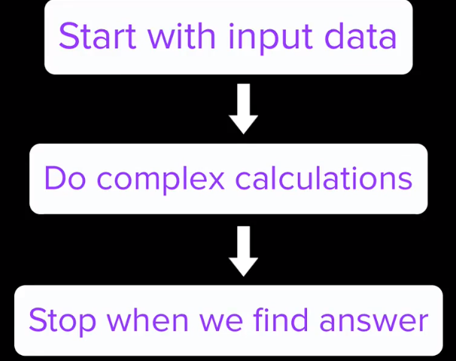
What is Algorithm?
A set of steps to accomplish a task

Slide 4

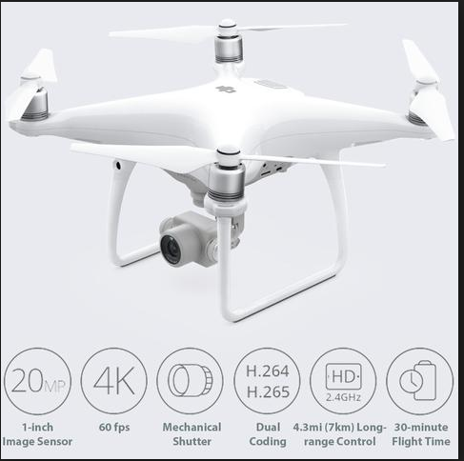
Real life examples - 1
H.264: video compression codec standard. Used largely in security systems, drones, phone, internet video….

Slide 5
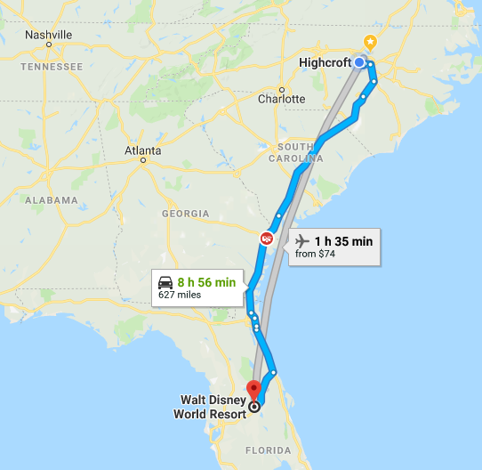
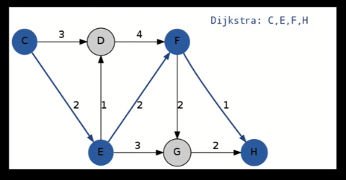
Real life examples - 2
Route finding algorithm

Slide 6

Real life examples - 3
Optimization & Scheduling Algorithms
How does NASA choose how to arrange the solar panels on
the International Space Station and when to rearrange them?

Slide 7
What do we need to learn Algorithm?
Learn from experiences
Applying the right steps to solve tasks
Save yourself some effort
Make your programs faster

Slide 8
Algorithms in different fields
Biological Sciences: new algorithms are continually being designed for molecular structures, that are the core of disease fighting drugs
Physics: algorithms simulate climate and weather patterns
Space: algorithms designed for accurate landing
Machine Learning: algorithms designed to train machine to make specific decisions.

Slide 9
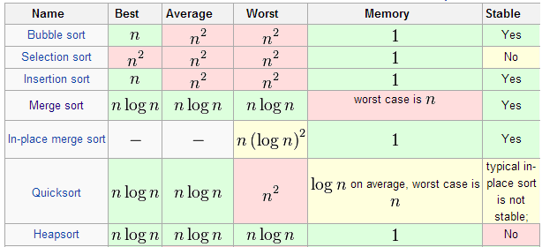
Populate Algorithms that dominate world
- Sorting algorithms
Fourier Transform and Fast Fourier Transform algorithms
Our entire digital world uses these simple but powerful algorithms, which transform signals from time domain into frequency domain.
The internet, WiFi, smartphone, phone, computer, router, satellites, almost everything that has a computer inside uses these algorithms in one way or another to function.

Slide 10
Populate Algorithms that dominate world
- Dijkstra’s algorithm
This graph search algorithm is used in different applications where the problem can be modeled as a graph and you have to find the shortest path between two nodes.
Data compression algorithms
Files, images, audio, video, games, data storage, cloud computing, databases…

Slide 11
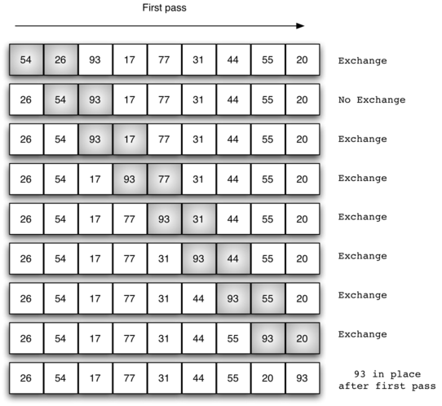
Algorithm examples – Bubble Sort
The bubble sort makes multiple passes through a list. It compares adjacent items and exchanges those that are out of order. Each pass through the list places the next largest value in its proper place. In essence, each item “bubbles” up to the location where it belongs.
At the start of the second pass, the largest value is now in place. There are n−1 items left to sort, meaning that there will be n−2 pairs.

Slide 12
Algorithm examples – Bubble Sort
Key parts of Bubble sort algorithm:
- loops
- Swap:
temp = alist[i]
alist[i] = alist[j]
alist[j] = temp

Slide 13
Algorithm examples – Chicken Rabbit Problem
Write a program to solve a classic ancient Chinese puzzle:
We count 35 heads and 94 legs among the chickens and rabbits in a farm.
How many rabbits and how many chickens do we have?
Def chicken_rabbit(total, numLegs):
for rabbits in range(total + 1):
chickens = total - rabbits
if 2 * chickens + 4 * rabbits == numLegs:
return chickens, rabbits
return 0, 0
result = chicken_rabbit (35, 94)
print("Number of chickens are %d and rabbits are %d." % result)

Slide 14
Algorithm examples – count character frequency
Print out the frequency of each character in a string, for example: input string is “abcdefgabc”, print out:
a,2
c,2
b,2
e,1
d,1
g,1
f,1

Slide 15
Algorithm examples – 2 Sums
Given an array of integers, return indices of the two numbers such that they add up to a specific target.
You may assume that each input would have exactly one solution, and you may not use the same element twice.
Example:
Array = [0,7,11,15,3,6,5,4], sum =6, return (1, 6)

Slide 16
Algorithm examples - Reverse Words in a String
Given a string, you need to reverse the order of characters in each word within a sentence while still preserving whitespace and initial word order.
Input: "Let's reverse this string as practice"
Output: “s'teL esrever siht gnirts sa ecitcarp”

